Slide 1


Prototyping and Wireframing: A Powerful Duo for Effective Design
Lecture-04
Course Code: CSE413
Course Title: Mobile Application Development

Slide 2
Learning Outcomes
What is Prototyping and Wireframing
Benefits of Prototyping and Wireframing
Effective ways of using these methodologies
Integration of Prototyping and Wireframing in development

Slide 3
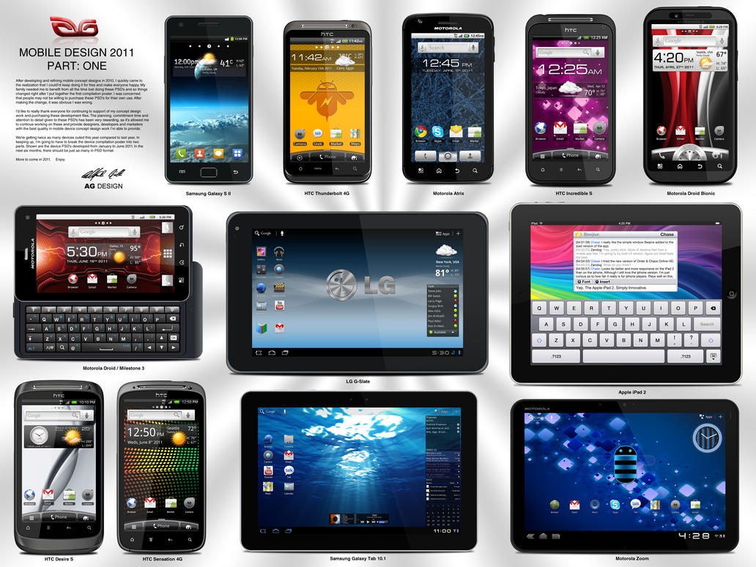
What is Prototyping?
Interactive Models:
Prototyping creates interactive models. These models simulate the final product. Users can test features. This provides valuable feedback early.
Early Testing
Prototyping allows for early testing. It helps in identifying potential issues. This is done before full development. This saves time and resources.

Slide 4

The Benefits of Prototyping
1
User Feedback
2
Cost Reduction
3
Stakeholder Alignment
Gather user feedback early. This ensures the final product meets user needs. Make necessary adjustments and improvements.
Identify and fix design flaws early. This reduces development costs. It avoids costly revisions later in the process.
Visualize the product for stakeholders. Gain their buy-in and ensure alignment. Everyone understands the vision.

Slide 5



Tools for Prototyping
Figma
Adobe XD
Collaborative design tool. It's used for creating interactive prototypes. It offers real-time collaboration.
Powerful prototyping tool from Adobe. It integrates with other Adobe products. It provides advanced features.

Slide 6
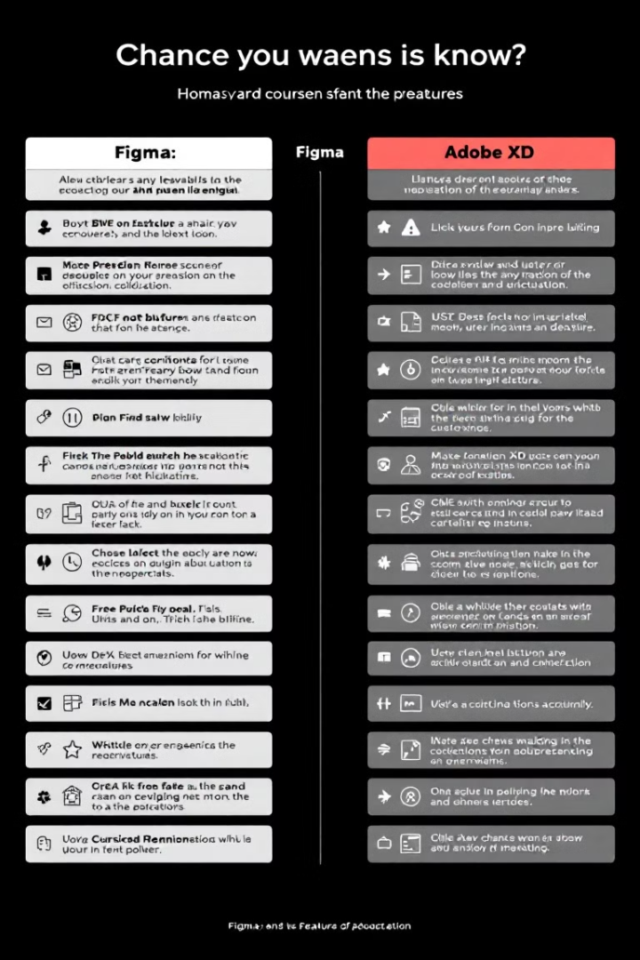
Comparison Between Figma and Adobe XD
Feature
Figma
Adobe XD
Collaboration
Excellent real-time collaboration
Good collaboration features
Integration
Limited integration
Seamless with Adobe products
Pricing
Free plan available
Part of Adobe Creative Cloud

Slide 7
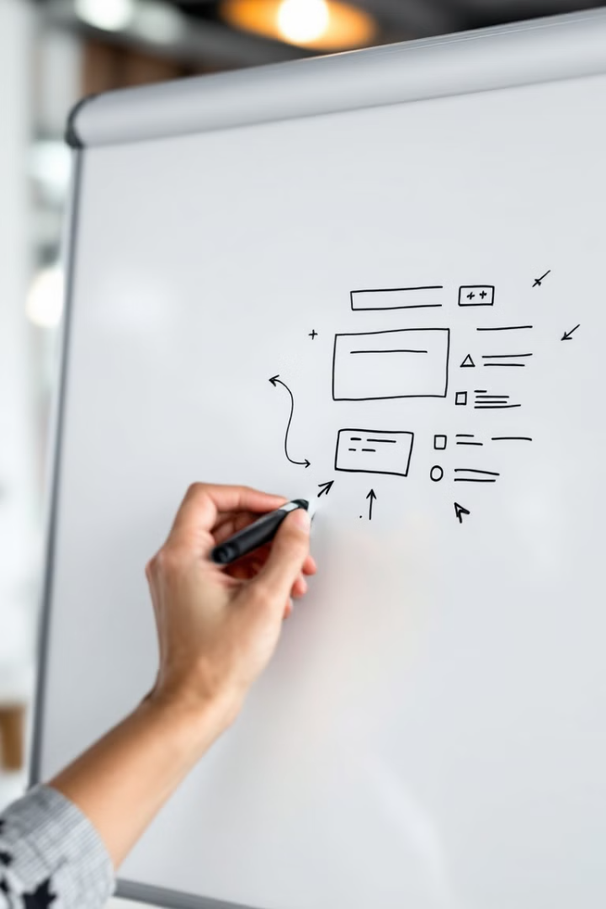



Wireframing: The Backbone of User Experience
Basic Structure
Wireframes outline the basic structure. They show the layout of a webpage or app screen.
Content Placement
They define where content goes. Images, text, and interactive elements are shown.
User Flow
Wireframes map out user flow. They show how users will navigate. This ensures usability.

Slide 8
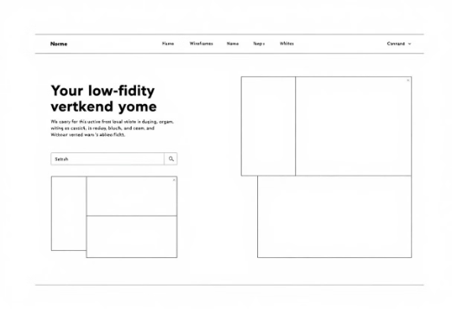

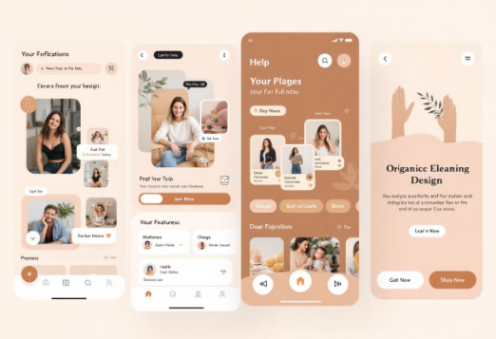
Wireframe Fidelity Levels
Low-Fidelity
Mid-Fidelity
High-Fidelity
Pros: Quick to create. Focuses on basic layout.
Pros: Balances detail. Clearer user flow.
Pros: Very realistic. Great for testing.
Cons: Time-consuming. Can distract.
Cons: Lacks detail. Can be misinterpreted.
Cons: Still lacks visual polish.

Slide 9
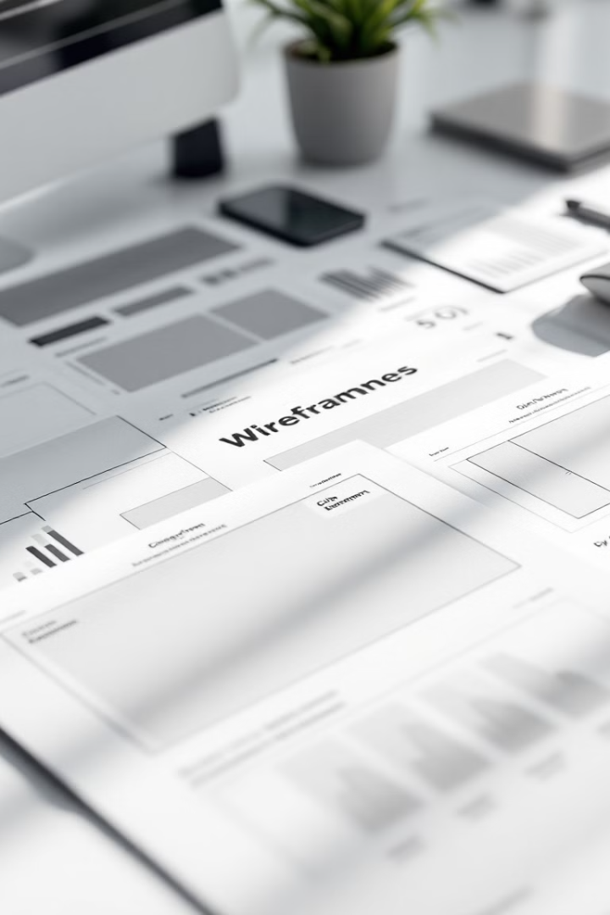
Effective Wireframing Techniques
Keep it Simple
Use Grids
Focus on structure and layout. Avoid unnecessary details.
Maintain consistent alignment. This helps create a clean look.
Prioritize Content
Highlight key information. Guide the user's eye.

Slide 10




Integrating Prototyping and Wireframing
Wireframe
1
Prototype
2
4
Refine
3
Test
Use wireframes as a foundation for prototypes. Build interactive experiences on solid structure. Test prototypes with users and iterate on designs. Combining both ensures a polished product.

Slide 11

The Iterative Design Process
1
Plan
Define goals and scope. Understand user needs.
2
Design
Create wireframes and prototypes. Develop user interfaces.
3
Test
Gather user feedback. Identify areas for improvement.
4
Refine
Implement changes. Iterate on designs.
Embrace the iterative design process for continuous improvement. Use feedback to refine and enhance the product. The user is at the center of the design journey.

Slide 12
Key Takeaways
Prototyping and Wireframing Necessity
Integration of Prototyping and Wireframing in Development
UX/UI design enhances usability : Tools like Figma & Adobe XD
Thank you

